Slide 1

DataBase

Slide 2
Python Database
The Python standard for database interfaces is the Python DB-API
Python Database API supports a wide range of database servers such as −
GadFly
mSQL
MySQL
PostgreSQL
Microsoft SQL Server 2000
Informix
Interbase
Oracle
Sybase

Slide 3
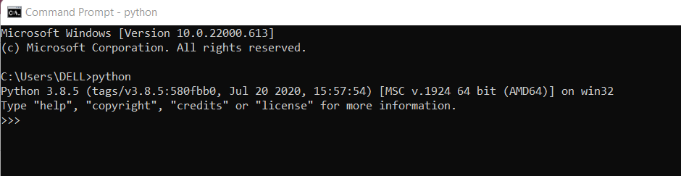
What is mysql-connector-python?
MySQL Python/Connector is an interface for connecting to a MySQL database server from Python.
First of all, you need to make sure you have already installed python in your machine. To do this open command prompt and type Python.

Slide 4
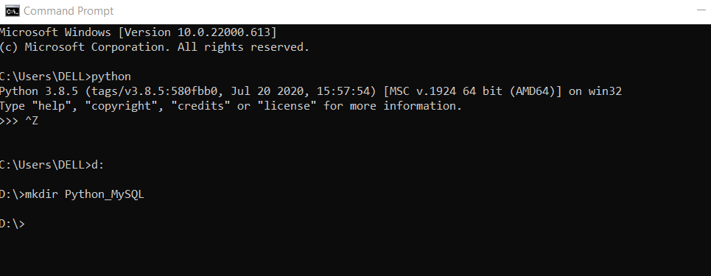
Now press ctrl+z and then Enter to get out of the python shell and create a folder (in which you intended to install Python-MySQL connector) named Python_MySQL as −

Slide 5
Verify PIP
PIP is a package manager in python using which you can install various modules/packages in Python. Therefore, to install Mysql-python mysql-connector-python you need to make sure that you have PIP installed in your computer and have its location added to path.

Slide 6
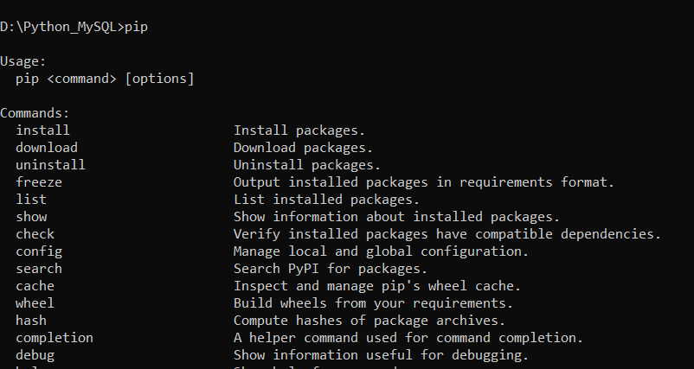

Slide 7
To install
Go to D->Python_MySQL and create a file get-pip.py
Copy and paste the code in the link
https://bootstrap.pypa.io/get-pip.py

Slide 8

Then give the command

Slide 9

Goto C->Users->DELL/ C:Python

Slide 10

Then open command prompt in admin mode and install python MySQL connect as −

Slide 11
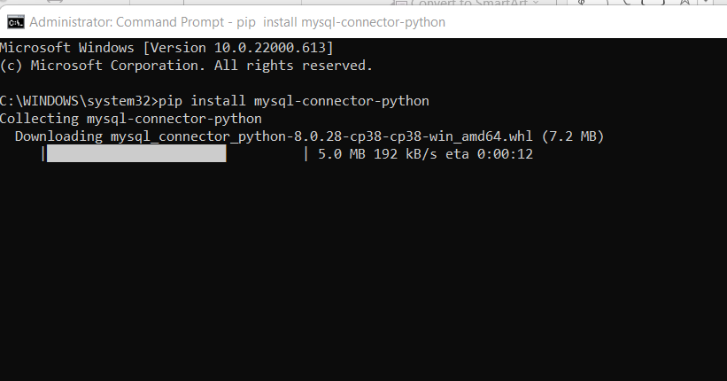
Installing

Slide 12
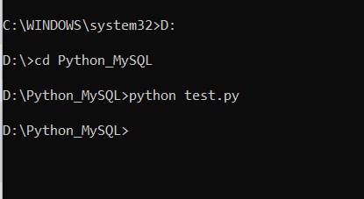
Verification
To verify the installation of the create a sample python script with the following line in it.

Slide 13
MYSQL Connections
import mysql.connector
#establishing the connection
conn = mysql.connector.connect(user='root', password='password', host='127.0.0.1', database='mydb')
#Creating a cursor object using the cursor() method
cursor = conn.cursor()

Slide 14
MYSQL Connections
#Executing an MYSQL function using the execute() method
cursor.execute("SELECT DATABASE()")
# Fetch a single row using fetchone() method.
data = cursor.fetchone()
print("Connection established to: ",data)
#Closing the connection
conn.close()

Slide 15
Connection
You can also establish connection to MySQL by passing credentials (user name, password, hostname, and database name) to connection.MySQLConnection() as shown below −
from mysql.connector import (connection)
#establishing the connection
conn = connection.MySQLConnection(user='root', password='password', host='127.0.0.1', database='mydb')
#Closing the connection
conn.close()

Slide 16
Creating MySQL table using Python
# importing required libraries
import mysql.connector
dataBase = mysql.connector.connect(
host ="localhost",
user ="user",
passwd ="password",
database = "gfg"
)

Slide 17
# preparing a cursor object
cursorObject = dataBase.cursor()
# creating table
studentRecord = """CREATE TABLE STUDENT (
NAME VARCHAR(20) NOT NULL,
BRANCH VARCHAR(50),
ROLL INT NOT NULL,
SECTION VARCHAR(5),
AGE INT
)"""
# table created
cursorObject.execute(studentRecord)
# disconnecting from server
dataBase.close()

Slide 18
Insert Data into Tables
# importing required libraries
import mysql.connector
dataBase = mysql.connector.connect(
host ="localhost",
user ="user",
passwd ="password",
database = "gfg"
)

Slide 19
# preparing a cursor object
cursorObject = dataBase.cursor()
sql = "INSERT INTO STUDENT (NAME, BRANCH, ROLL, SECTION, AGE)\
VALUES (%s, %s, %s, %s, %s)"
val = ("Ram", "CSE", "85", "B", "19")
cursorObject.execute(sql, val)
dataBase.commit()
# disconnecting from server
dataBase.close()

Slide 20
Fetching Data
# importing required libraries
import mysql.connector
dataBase = mysql.connector.connect(
host ="localhost",
user ="user",
passwd ="password",
database = "gfg"
)

Slide 21
# preparing a cursor object
cursorObject = dataBase.cursor()
query = "SELECT NAME, ROLL FROM STUDENT"
cursorObject.execute(query)
myresult = cursorObject.fetchall()
for x in myresult:
print(x)
# disconnecting from server
dataBase.close()

Slide 22
Where Clause
# importing required libraries
import mysql.connector
dataBase = mysql.connector.connect(
host ="localhost",
user ="user",
passwd ="password",
database = "gfg"
)

Slide 23
# preparing a cursor object
cursorObject = dataBase.cursor()
query = "SELECT * FROM STUDENT where AGE >=20"
cursorObject.execute(query)
myresult = cursorObject.fetchall()
for x in myresult:
print(x)
# disconnecting from server
dataBase.close()

Slide 24
Order By clause in MySQL using Python
# preparing a cursor object
cursorObject = dataBase.cursor()
query = "SELECT * FROM STUDENT ORDER BY NAME DESC"
cursorObject.execute(query)
myresult = cursorObject.fetchall()
for x in myresult:
print(x)
# disconnecting from server
dataBase.close()

Slide 25
Update Data
query = "UPDATE STUDENT SET AGE = 23 WHERE Name ='Ram'"
cursorObject.execute(query)
dataBase.commit()
# disconnecting from server
dataBase.close()

Slide 26
Delete Data from MySQL table using Python
# preparing a cursor object
cursorObject = dataBase.cursor()
query = "DELETE FROM STUDENT WHERE NAME = 'Ram'"
cursorObject.execute(query)
dataBase.commit()
# disconnecting from server
dataBase.close()

Slide 27
Drop Table in MySQL using Python
query ="DROP TABLE Student;"
cursorObject.execute(query)
dataBase.commit()
# disconnecting from server
dataBase.close()

Slide 28
Transactions
Using ACID properties, we can study transaction management well. ACID stands for Atomicity, Consistency, isolation, and durability.
Atomicity: means all or nothing. Either all transactions are successful or none. You can group SQL statements as one logical unit, and if any query fails, the whole transaction fails.
Consistency: It ensures that the database remains in a consistent state after performing a transaction.
Isolation: It ensures that the transaction is isolated from other transactions.
Durability: It means once a transaction has been committed, it persists in the database irrespective of power loss, error, or restart system.

Slide 29
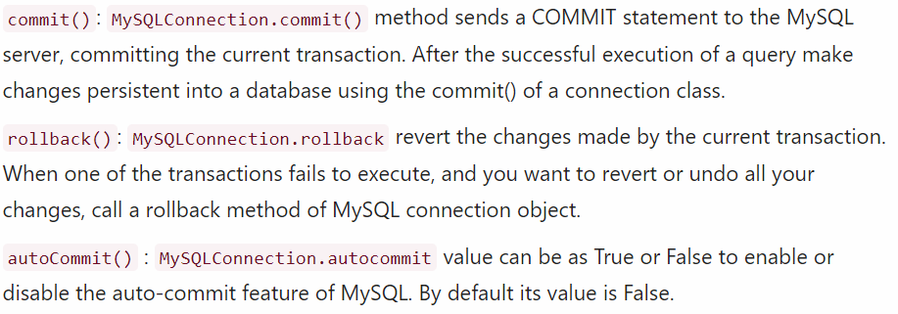
Python MySQL Commit(), rollback() and setAutoCommit() to manage transactions

Slide 30
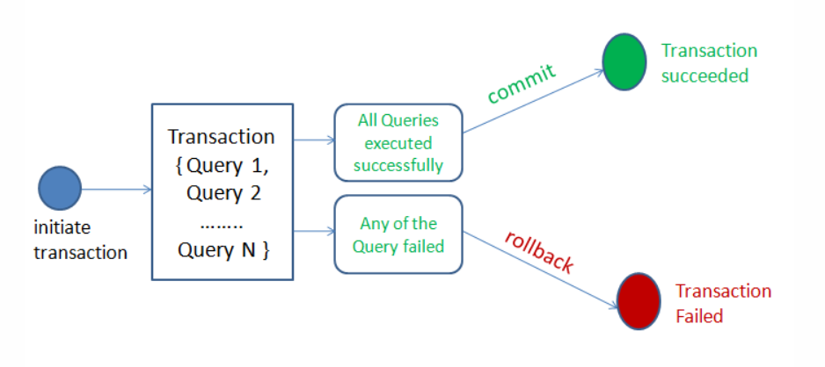

Slide 31
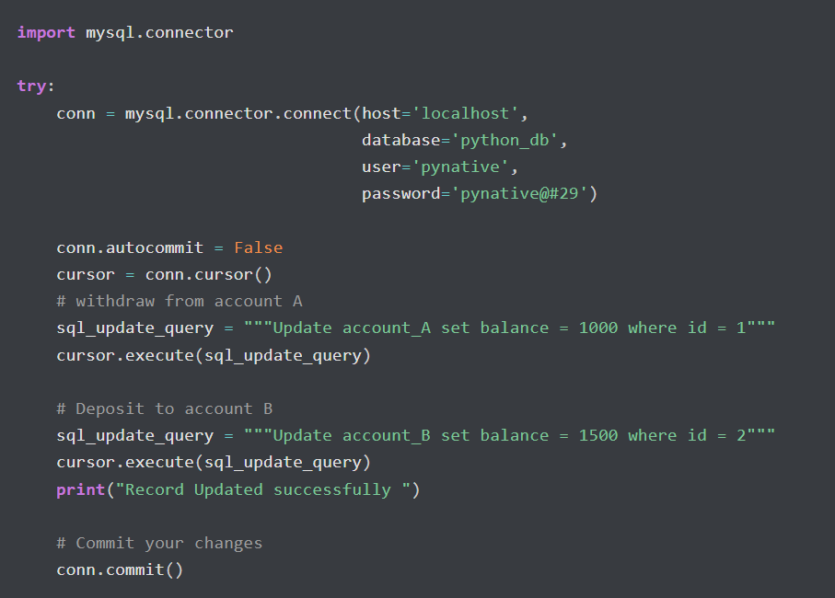

Slide 32
